Slide 1
INTRUSION DETECTION
SYSTEM

Slide 2
INTRODUCTION
Intrusion Detection Systems (IDS) are commonly used in homes, offices, warehouses, factories to enhance security, especially during non-operational hours.
Passive Infrared (PIR) sensors detect infrared radiation emitted by warm objects like humans.
When a person or object passes within the sensor's detection range, it triggers an alarm or sends an alert.
PIR sensors are typically placed at entry points, doors, or high-traffic areas to monitor motion and detect potential intrusions.
They are commonly used due to their cost-effectiveness, low power consumption, and reliability for detecting human movement in a defined area.

Slide 3
Components Used: ESP 32 Wifi Module, IR Sensors
Software: Arduino IDE
Language Used: Embedded C
DataBase: Firebase
App FrameWork: Blynk App, MIT Inventor App, Streamlit WebApp

Slide 4
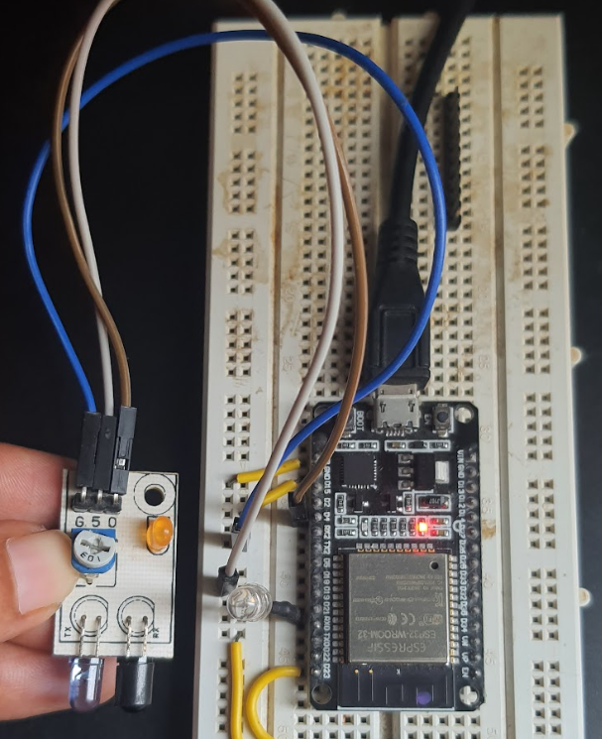
Hardware Setup

Slide 5
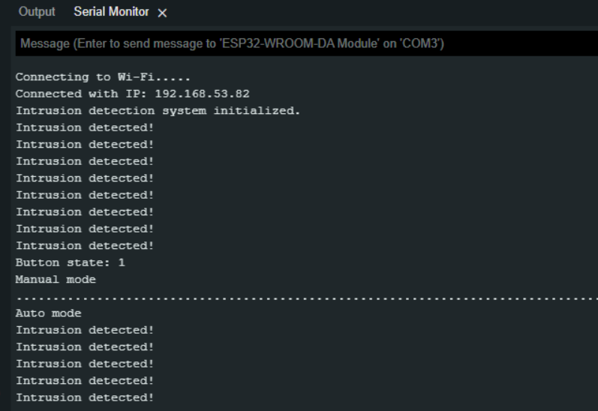
Arduino IDE

Slide 6
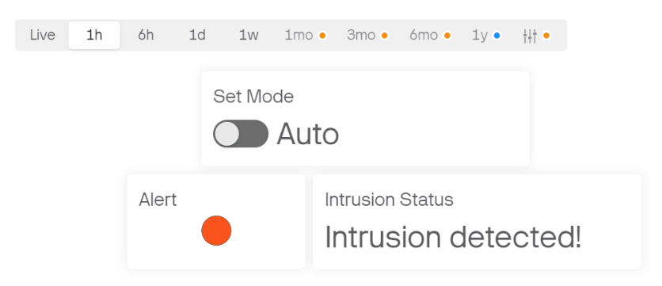
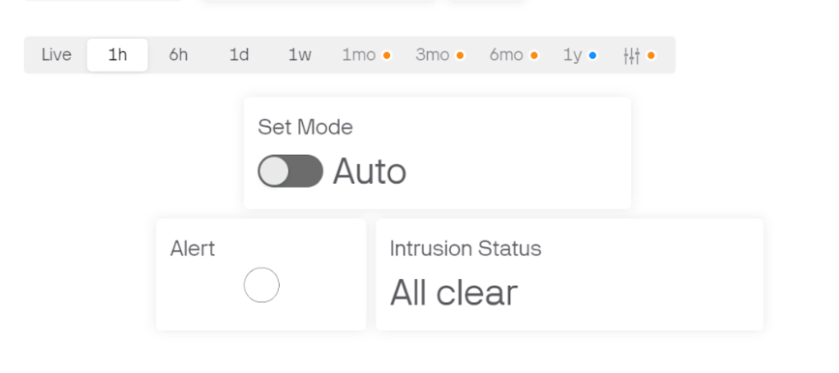
Blynk Dashboard

Slide 7
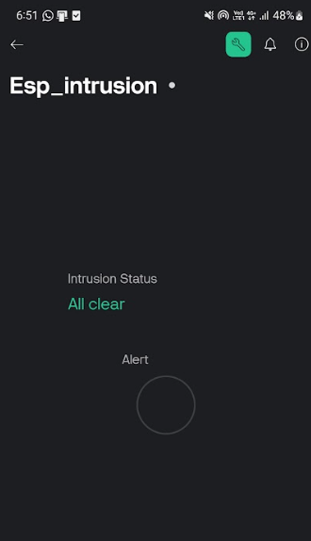
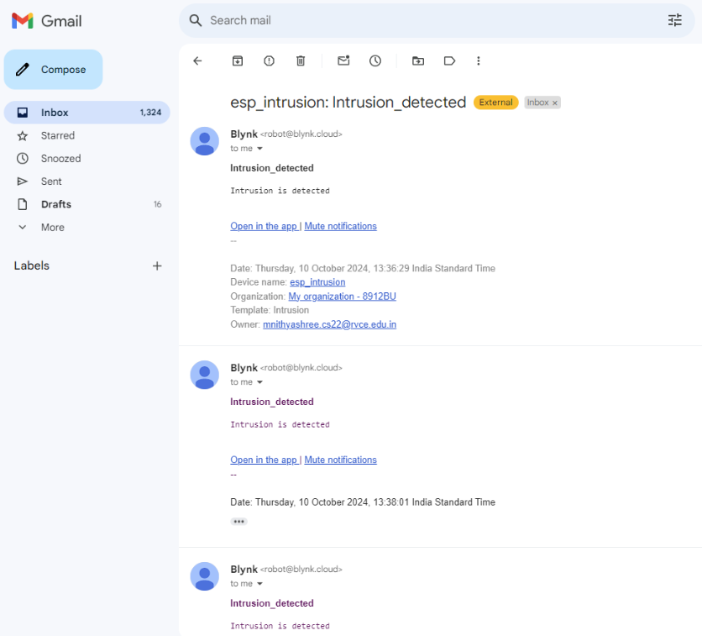
Blynk App

Slide 8
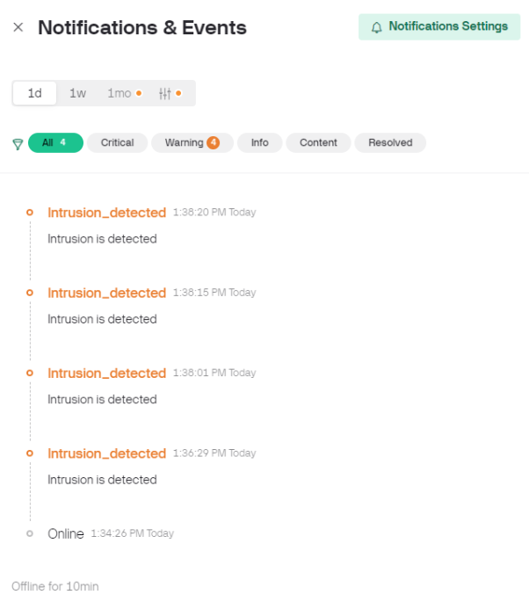
Blynk App

Slide 9
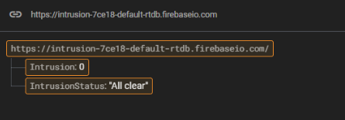
Firebase Database

Slide 10
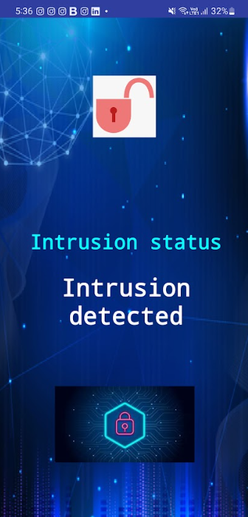
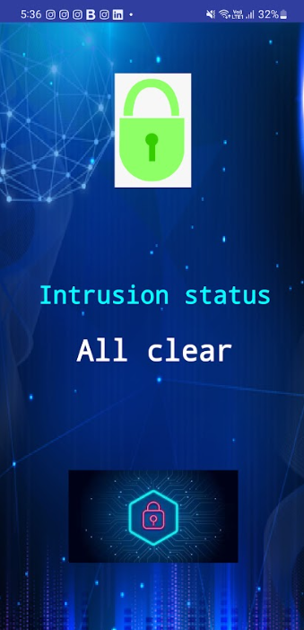
MIT Inventor App

Slide 11
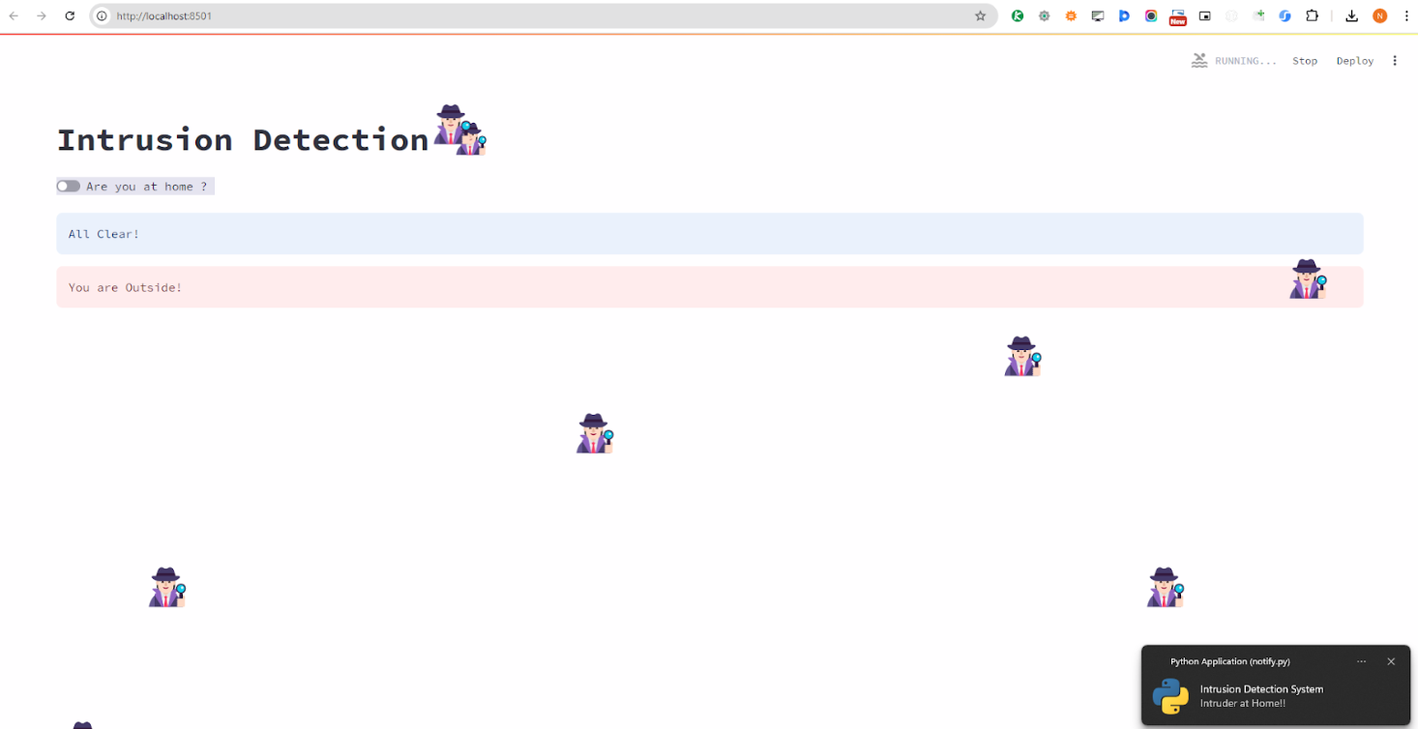
Streamlit WebApp

Slide 12
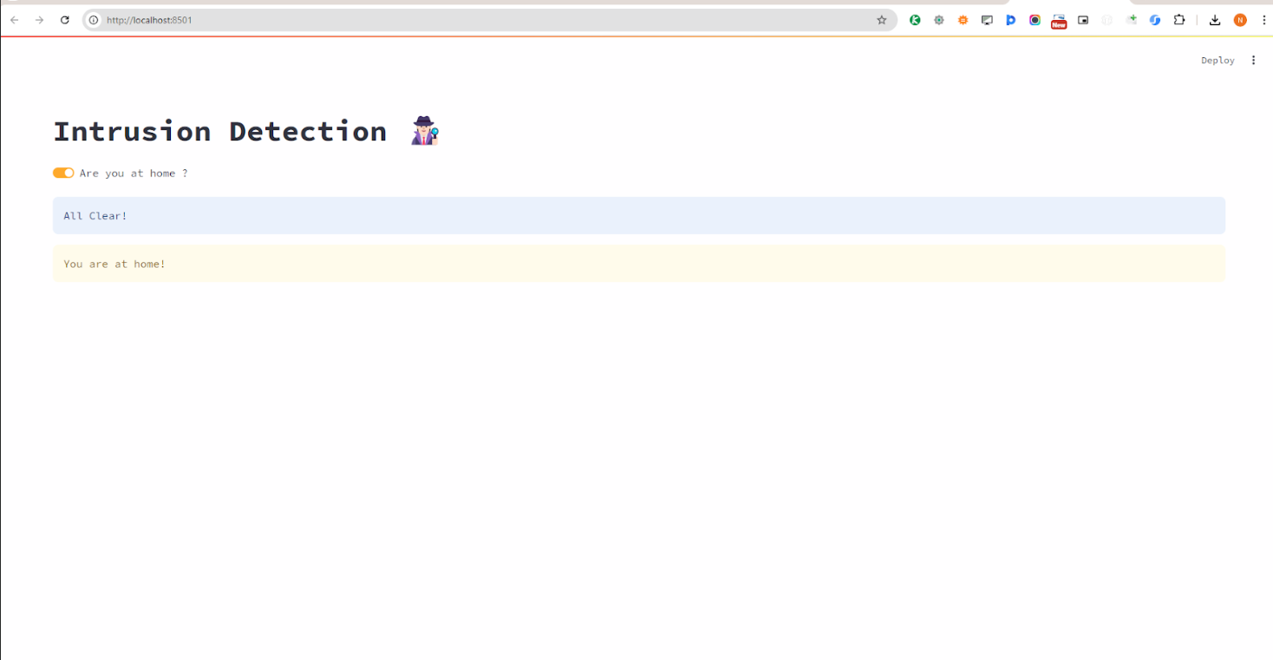
Streamlit WebApp

Slide 13
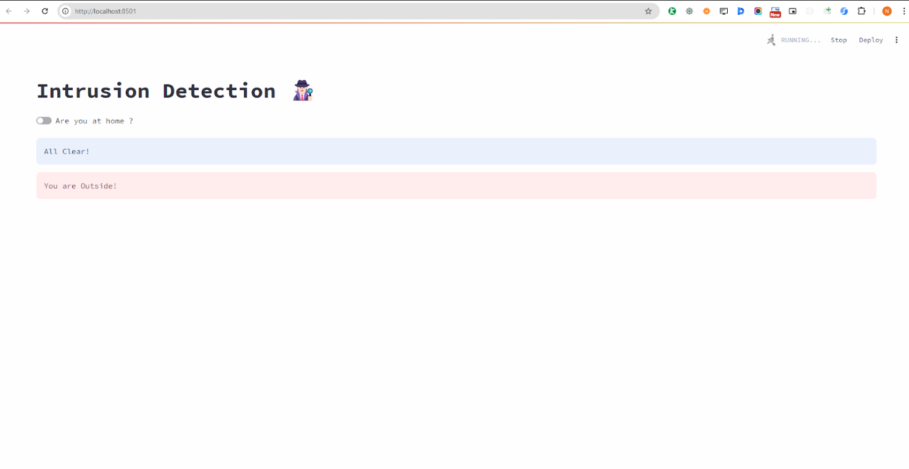
Streamlit WebApp

Slide 14
VIDEO LINK
https://drive.google.com/file/d/1UQ8FeMgYlmJ6qznttVo3m8MKyRk7F1Tb/view?usp=drive_link

Slide 15
APPLICATIONS
Home Security: Monitors for unauthorized entry, sending alerts to homeowners or security services.
Banking & Financial Institutions: Protects vaults, ATMs, and secure areas, providing real-time alerts to authorities in case of breaches.
Government Buildings: Protects high-security areas, ensuring only authorized personnel access sensitive locations.
Data Centers: Safeguards critical infrastructure by detecting intrusions in sensitive zones like server rooms.

Slide 16
THANK YOU

